Slide 1
Mayflower Community Academy Support Centre

Slide 2
Autism
Autism is a neurological difference that impacts how a person develops. There are three main areas of difference:
Communication and interaction: Differences in understanding and expressing communication and language, ranging from some individuals with little speech to those who are very articulate but still find communication hard. There are also differences in social understanding and understanding the feelings of others, which can influence building relationships.
Sensory processing: Differences in processing sensory information, such as touch, smell, hearing, taste, vision, body balance and body awareness. Some individuals may react more strongly to these (hyper-sensitive), while others may seek these stimulations (hypo-sensitive).
Flexible thinking and information processing: Differences in planning and processing information. This can influence generalisation and understanding of concepts. There may also be intense interest in specific topics or areas.
These differences could also bring some unique skills and talents, which could provide a different way of understanding and being. To acknowledge this difference, none of the resources in this suite use the word ‘disorder’. We have used the word autism or autism spectrum. Some people on the autism spectrum consider autism as the core of their self-identity and prefer using identity-first language, such as ‘autistic person’. Others feel that autism does not define them as an individual and prefer individual-first language, such as ‘person with autism’. In acknowledgement of these differing views and the fact that most of the research around preference of terminology does not include children’s voices, we have used a combination of terminology based on whether the resource is for adults or children.
Autism Education Trust

Slide 3
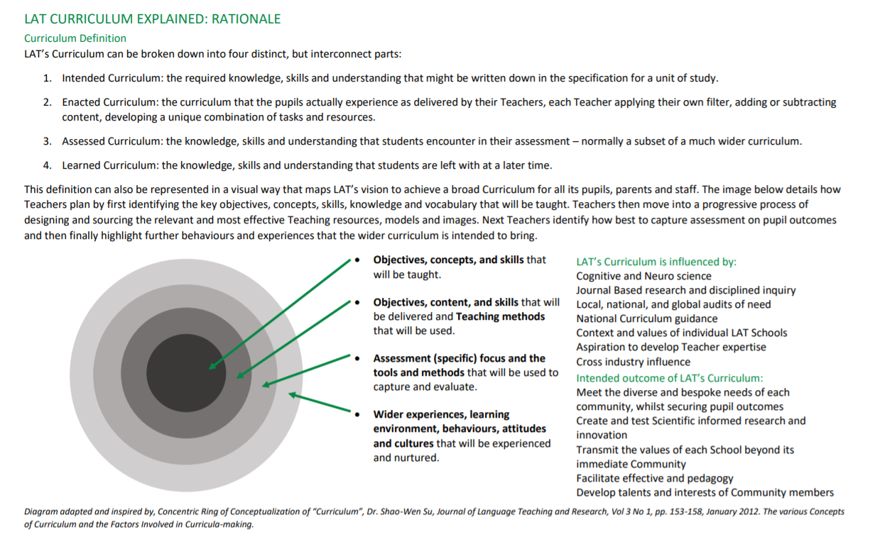
Intent: Curriculum Overview

Slide 4
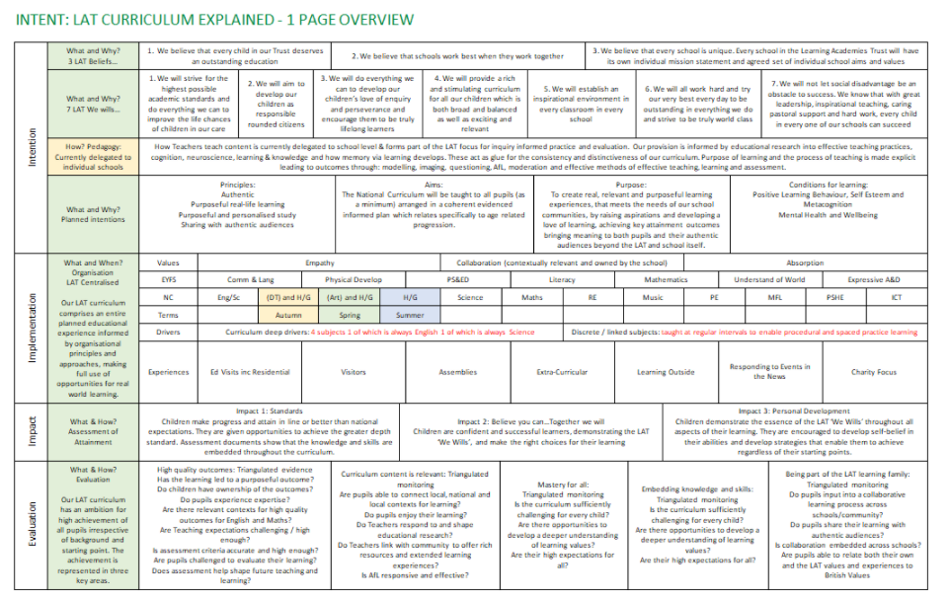

Slide 5
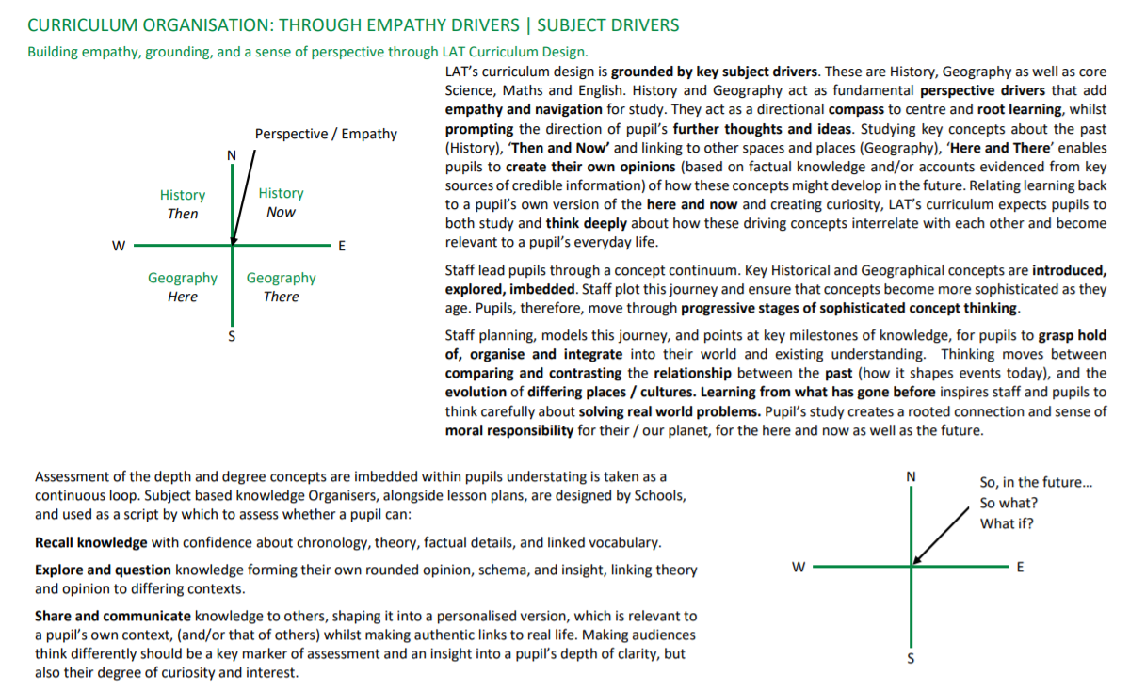
Intent: Curriculum Organisation

Slide 6
The Support Centre
Mayflower Support Centre, part of Mayflower Community Academy and Nursery, was opened as a purpose built centre in 2009.
The centre has space for 12 pupils from Year 1 – Year 6. Pupils gain entry into the Support Centre through the Primary Placement Panel which is led by the local authority.
The Support Centre follows the same principals as the Academy and has an embedded culture of high expectations and collective responsibility to achieve excellence for all pupils. Our curriculum combines academic, social and physical targets and audits the academic needs, talents and interests of the pupils as a whole, whilst also personalising activities to meet their complex needs. Pupils are provided with equality of opportunity through bespoke and challenging teaching by all staff members.
All pupils within the Support Centre have an Education, Health and Care Plan (EHCP) which highlights their strengths and needs as identified by parents, teaching staff and outside agencies.
The Support Centre provision is designed to create opportunities for pupils to take risks, make mistakes and communicate their feelings in a clear and confident way. They are taught how to listen to each other’s point of view and encouraged to share their own thoughts and opinions.

Slide 7
Curriculum Rationale
Together we can …
Our curriculum has been primarily based on the National Curriculum and the curriculum implemented by the Learning Academy Trust as well as following the guidelines set out by the Autism Education Trust. Our curriculum addresses the wide needs and abilities of each individual pupil. It ensures that each child can experience success as well as incorporate specialist areas such as sensory diet and life skills to best meet the academic, social and emotional needs of each child. They have opportunity to experience a full broad curriculum to the highest standard. It supports them in leading a full and independent life.

Slide 8
Curriculum Rationale
Formative and Summative assessments will inform the starting point of each child in every subject. The curriculum is adapted to suit the pupils and therefore, there may be a variety of different learning activities and outcomes within each lesson.
Adults within the Support Centre strive to get to know the pupils and their family enabling bespoke and personalised activities. For example, each pupil has a personalised Positive Learning Behavior Chart, an individual sensory diet and personalised targets.
All our pupils learn and achieve in different ways and planning will be adapted to suit this. This may include:
First and next cards,
Visual timetables
Visual information and prompts
Chunking longer tasks
Widgets
Sentence stems
Picture/ word prompts
Knowledge Organisers
Partially completed examples
Modelled examples/images / concept maps
Recording devices to communicate written work.

Slide 9
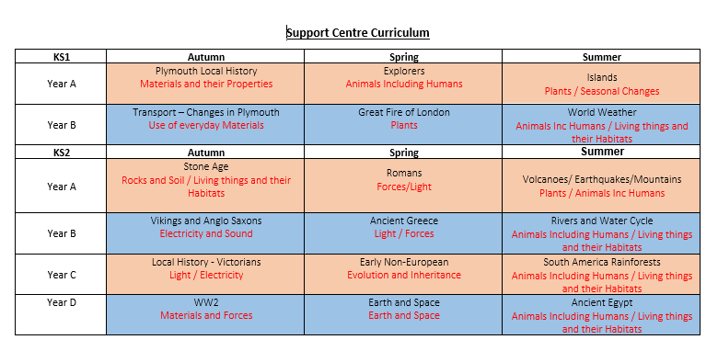
Implementation: Curriculum

Slide 10
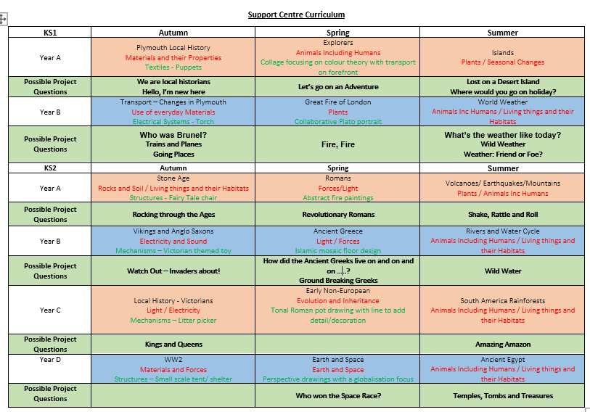
Implementation: Curriculum

Slide 11
Implementation: Curriculum

Slide 12
Implementation – Curriculum EYFS
Each pupil following the EYFS curriculum has an individualised programme based upon their stage of learning. The children will follow the Early Learning Goals and Development Matters statements. They have personalised speech and language sessions with catered activities recommended by Livewell Southwest Specialists. They follow the EYFS White Rose Maths Programme and Phonics Bug programme for Literacy.
In addition, the pupils participate in structured play and life skills daily that encourage their speech and language, turn taking, independence and understanding of the world. Their sensory diet supports pupils with their proprioception thus helping them to self regulate.

Slide 13
Implementation: Trivium
We work towards the theories of Trivium but with a key understanding that due to the pupils autistic tendencies, they may have difficulty in being able to achieve in each area.
To support Teachers ability to make judgements on their pupils depth of understanding, and the effectiveness of their teaching, LAT has been heavily influenced by the work of Martin Robinson and his theory of Trivium. The influence of this theory varies according to the national curriculum subject being assessed. Using Trivium as a guide, staff work within a framework to formatively assess whether a pupil can:
Recall knowledge with confidence about chronology, theory, factual details and linked vocabulary.
Explore and question knowledge forming their own rounded opinion, schema and insight, linking theory and opinion to differing contexts.
Share and communicate knowledge to others, shaping it into a personalised version, which is relevant to a pupil’s own context, (and/or that of others) whilst making authentic links to real life. Making audiences think differently should be a key marker of assessment and an insight into a pupil’s depth of clarity, but also their degree of curiosity and interest.

Slide 14
Implementation: Trivium
MODEL: the opportunity to learn and recall information and knowledge.
What do you want the children to know? How can the children retrieve information?
EXPLORE AND QUESTION: the opportunity to question and explore, compare and contrast.
How can the children explore that knowledge?
DECLARE AND SHARE: the opportunity to communicate, declare and share an educated opinion.
How do you want the children to communicate and share what they have learnt?

Slide 15
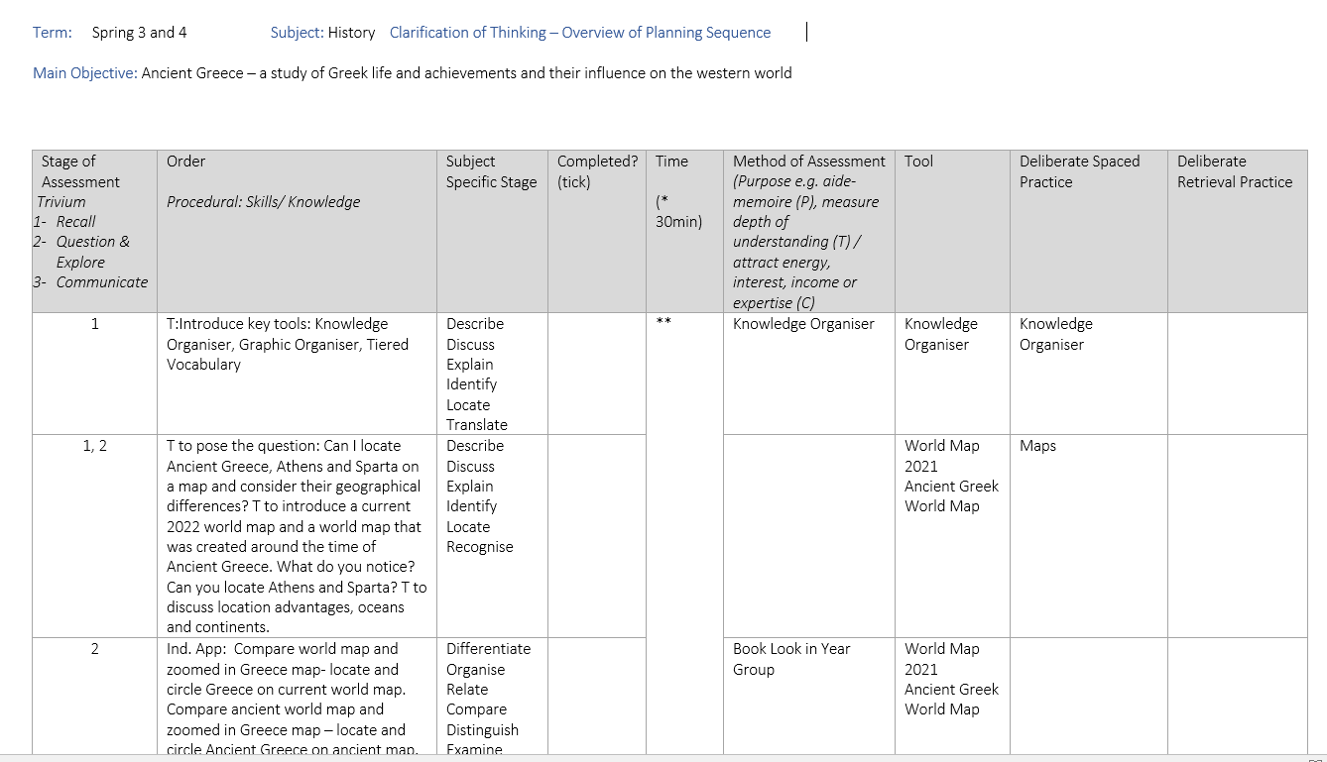
Planning and Sequence of Learning
Clarification of Thinking
The Clarification of Thinking document, encourages a deliberate and considered approach of how to select and organise planning. Trivium is embedded throughout the Clarification of Thinking process to ensure there is a planned progression from the Recall to the Declare and Share stages.

Slide 16
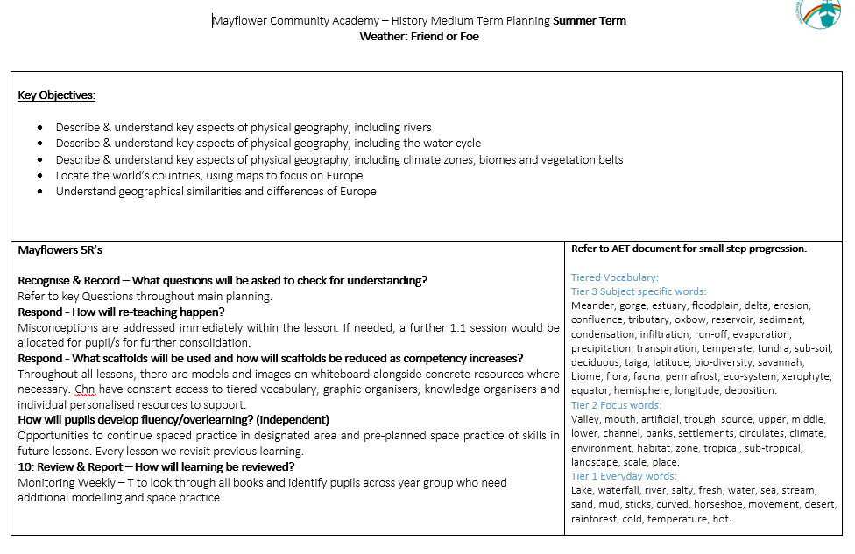
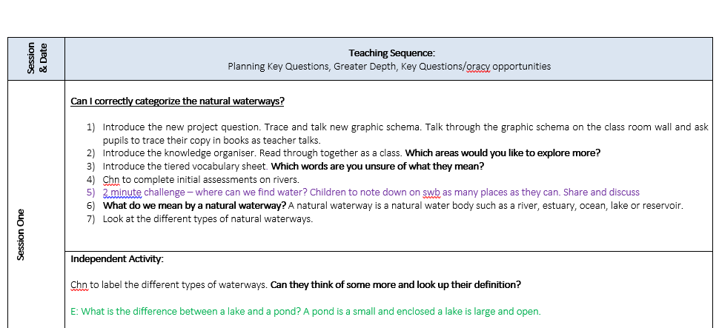
Planning and Sequence of Learning

Slide 17
Progression Framework (AET)
The AET Progression Framework is designed to support staff identifying learning priorities and measuring progress in areas that relate closely to autism differences and the impact of these differences on the young person’s social, emotional, independence and learning needs.
It addresses skills and understanding that children may find difficult but also strives to recognise and build on strengths and interests and to improve overall wellbeing.
It lays emphasis on supporting the child to understand both their own and others’ behaviour, what might be expected within certain situations, and how this might be of benefit.

Slide 18
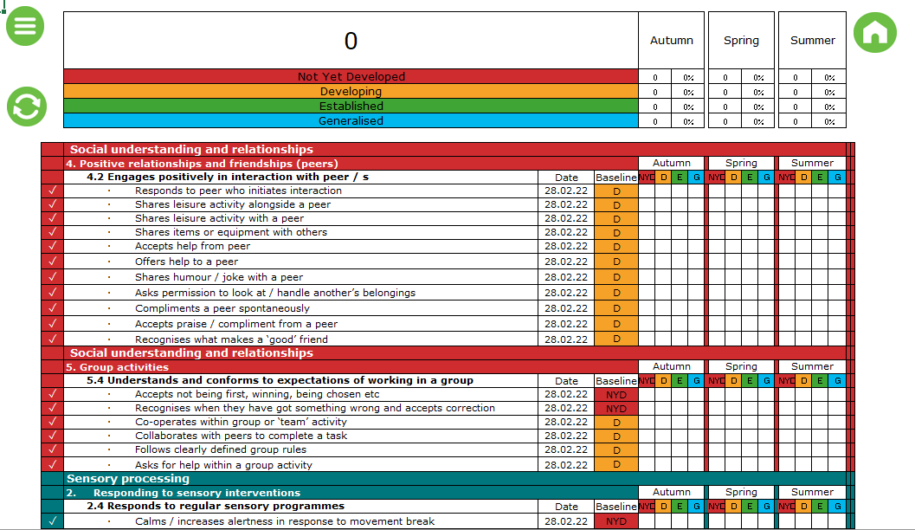
Progression Framework (AET)

Slide 19
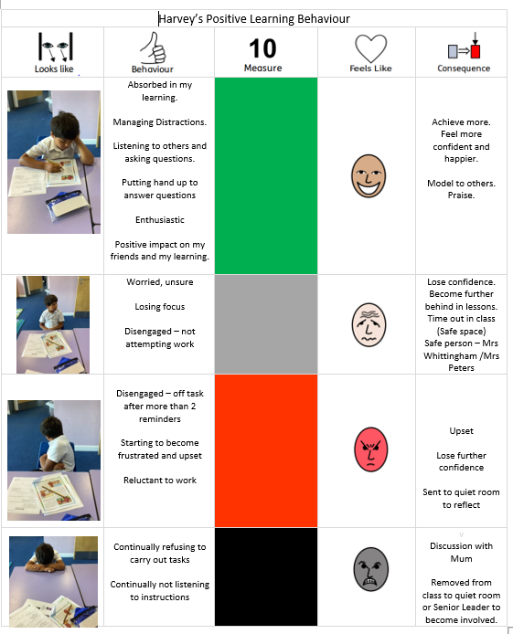
Personalisation – Positive Learning
Each child within the Support Centre has their own Positive Learning Behaviour Tracker which is personalised to their individual needs.
Pupils with Autism display very different behaviours therefore it is crucial that staff within the Support Centre build positive relationships in order to identify these behaviours, identify triggers and discuss positive or negative consequences.
We feel it is vital that the pupil is involved as much as possible when designing their trackers.
All behaviour happens for a reason, and understanding the function, as well as finding the ‘trigger’, is key to managing it positively. An outburst may be a known reaction to a daily activity or stimuli. Sometimes it may be so unexpected that it can be difficult to ascertain the cause. It’s a way of communicating.

Slide 20
Why do we incorporate Self-Regulation / Social Skills?
Within the Support Centre pupils have regular ‘Self Regulation Time’. Self Regulation Time runs for a short period after every lesson, for the children to calm and self regulate. This allows pupils to consolidate their learning, process information, address misconceptions ask questions and attend positively to the next area of learning.
Break times include structured games and activities which provide enhanced opportunity to support pupils to develop their social and team building skills. This helps to build positive relationships in teacher led activities with clear rules, instructions and boundaries. During afternoon break, the children can access the Sensory Garden. This provides time to have more individual play alongside their peers, encouraging their independence and decision making. Going forward, we plan to create a planting area where the pupils work alongside teachers promoting healthy choices and during the summer months, access more sensory (water/sand) activities.
Notes:
Self regulation Time (You choose) – this is after every lesson, in order for the children to calm and self regulate, allowing them to consolidate their learning, process information they’ve learnt, address misconceptions or further questioning that they have ready to attend positively to the next area of learning.
Structured break times – structured games/activities during morning break time, providing enhance opportunity to support pupils develop their social skills and team building as well as building positive relationships in a teacher led activity with clear rules, instructions and boundaries. During afternoon break, the children have the opportunity to access the sensory garden. Time to have more individual play alongside their peers, encouraging their independence and decision making. Going forward, we plan to create a planting area that the pupils work alongside teachers to build, promoting healthy choices and during the summer months, children can access more sensory (water/sand) activities.
Lunch – children have set routines and eat together with 1 adult per class. They are encouraged to use manners, positive conversations, turn taking, sharing, waiting patiently, effective communication and overall building positive relationships.
Sensory Diet – Self regulation and self awareness, chance to understand and express their emotions and manage their emotions and behavior whilst developing their confidence and self esteem. Sensory room / scooter boards / sensory equipment.

Slide 21
Why do we incorporate Self-Regulation / Social Skills?
Children have set routines at lunch time and eat together with 1 adult per class. They are encouraged to use manners, engage in positive conversations, turn take, share, wait patiently and overall, build positive relationships.
The Sensory Diet provides pupils the opportunity for further self regulation and self awareness. It provides them with the chance to understand and express their emotions whilst developing their confidence and self esteem. Activities include the sensory room, scooter boards and sensory equipment.
The Support Centre also provides opportunities to develop key Life Skills (Cooking, Planting, Computing skills, Social Skills, Oracy, managing money). This Provides opportunities to live a safe, happy and independent life with an understanding of the world around them and their place in it.
Notes:
Self regulation Time (You choose) – this is after every lesson, in order for the children to calm and self regulate, allowing them to consolidate their learning, process information they’ve learnt, address misconceptions or further questioning that they have ready to attend positively to the next area of learning.
Structured break times – structured games/activities during morning break time, providing enhance opportunity to support pupils develop their social skills and team building as well as building positive relationships in a teacher led activity with clear rules, instructions and boundaries. During afternoon break, the children have the opportunity to access the sensory garden. Time to have more individual play alongside their peers, encouraging their independence and decision making. Going forward, we plan to create a planting area that the pupils work alongside teachers to build, promoting healthy choices and during the summer months, children can access more sensory (water/sand) activities.
Lunch – children have set routines and eat together with 1 adult per class. They are encouraged to use manners, positive conversations, turn taking, sharing, waiting patiently, effective communication and overall building positive relationships.
Sensory Diet – Self regulation and self awareness, chance to understand and express their emotions and manage their emotions and behavior whilst developing their confidence and self esteem. Sensory room / scooter boards / sensory equipment.

Slide 22
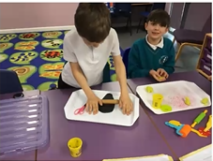
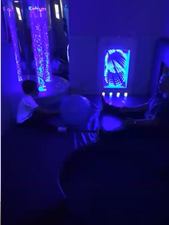
Sensory Diet
A Sensory Diet is a personalised plan of activities designed to meet a child’s sensory needs.
The aim is to support the pupil to regulate themselves and become calm and alert so that they can engage in the activities of the day.
It is an essential part of a pupils’ day.
This can include activities that help pupils deescalate when they are over stimulated.
Having the right sensory input helps pupils to pay attention in school, learn new skills, and socialise with other children.

Slide 23
Sensory Diet

Slide 24
Social Skills Sessions
Our social skills sessions follow the 5 steps to mental wellbeing (NHS) and the Autism Education Trust Framework. These are:
1) Connect with people (building positive experiences and supporting to build a sense of belonging and self worth).
2) Be Physically Active (raising self esteem, setting goals and positively changing moods).
3) Learning New Skills ( building a sense of purpose, boosting self-confidence, connecting with others).
4) Give to Others (Creating positive feelings, self worth and a sense of reward).
5) Pay Attention to the present moment (mindfulness).

Slide 25
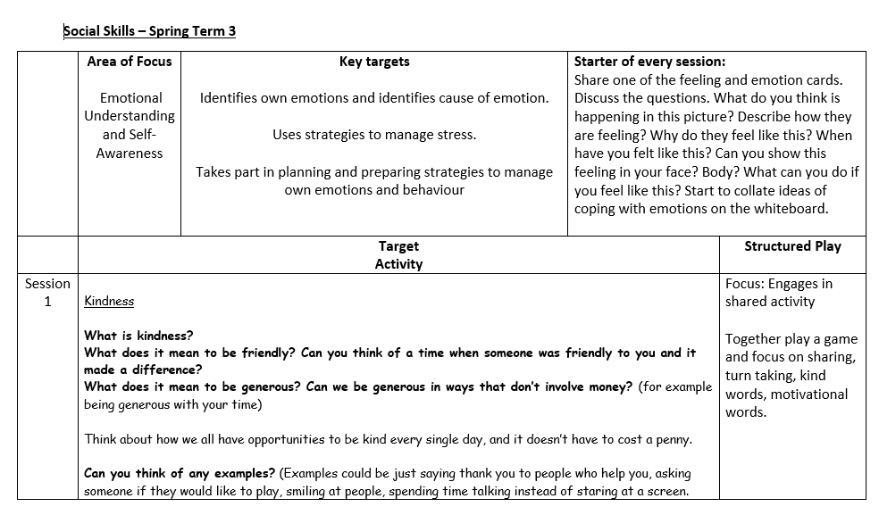
Social Skills Session Planning

Slide 26
Tools for Learning
Within the Support Centre the pupils have access to a wide range of tools and resources to support with their learning and their physical, social and emotional needs.
These include: Knowledge Organisers, Graphic Schemas, Tired Vocabulary, Live Modelling, Retrieval Practice, Spaced Practice, Questioning.
Widgit symbols, Fidgit tools, Wobble Cushions, Now and Next prompts, clear timetables, individual behavior charts, models and images, sensory room, scooter boards, sensory equipment

Slide 27
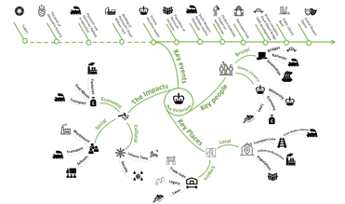
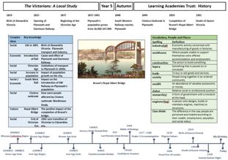
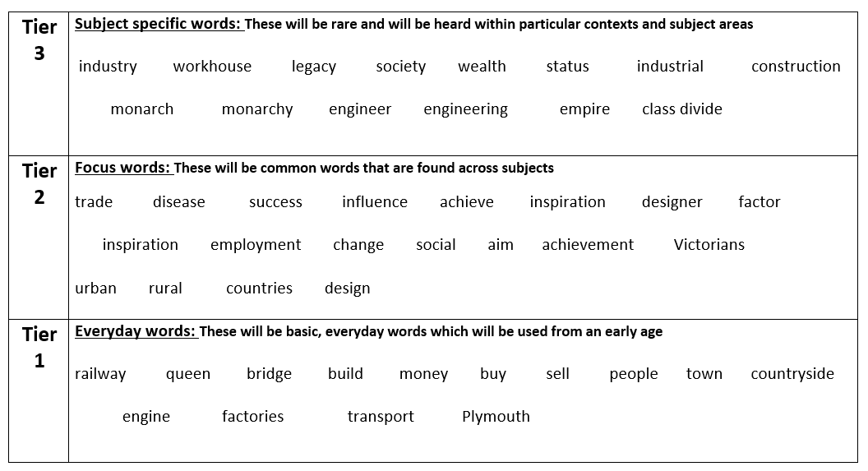
Retrieval Practice / Model
Pupil’s will use their finger to trace over each part of the Graphic Organiser and talk about what they know as they come to each part. Confident pupil’s will be able to expand on certain points and use more sophisticated language found in Tier 3 on their Tiered Vocabulary Wall.
Pupil’s can use their Knowledge Organiser and Tiered Vocabulary along side them to help remember key information. The visuals are important reminders about key facts.
Provide the vocabulary that pupils need to understand and integrate into their learning.
Provides an organised and structured tool supporting the recall of knowledge and vocabulary.
Knowledge Organisers provide facts.

Slide 28
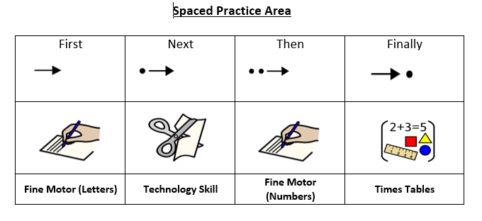
Spaced Practice
Our spaced practice area has been designed to support pupils with their key skills and fine motor skills. This is a functional and flexible space to practice these skills.

Slide 29
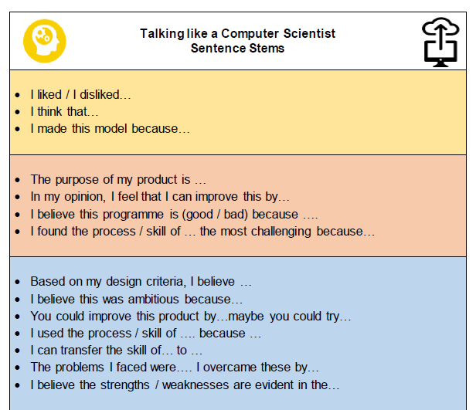
Scaffolding to Aid Progression
Scaffolding process are used to support pupils in reaching their goals ensuring all make progress.
This can look like:
Widgits
Sentence stems
Picture/ word prompts
Knowledge Organisers
Partially completed examples
Modelled examples/images / concept maps

Slide 30
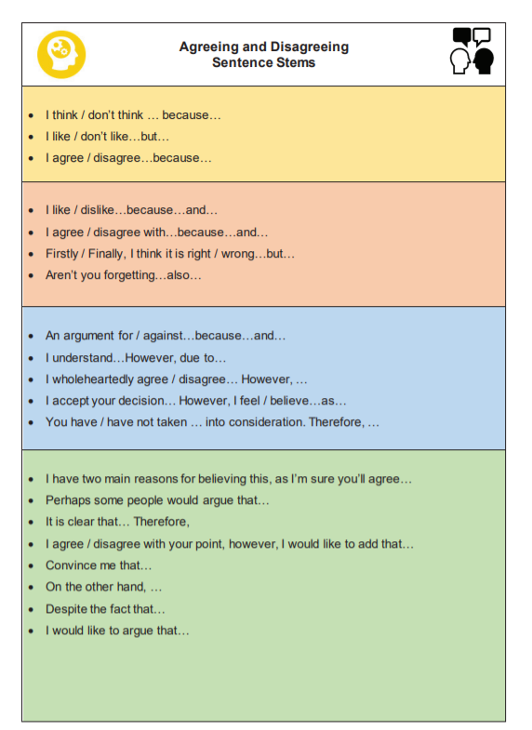
Declare and Share
Our Functional Language Booklets are specifically designed for pupils at Mayflower Community Academy. The booklets are a way of providing each individual pupil with a booklet of sentence stems. This opportunity supports pupils to respond in the form of a complete sentence to effectively communicate.
Sentence stems provide scaffolding to help pupils recognise the range of ways we can engage in talk and is a tool to get started in speaking or writing without the added pressure of thinking about how to correctly formulate a response.

